Slide 1

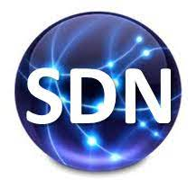
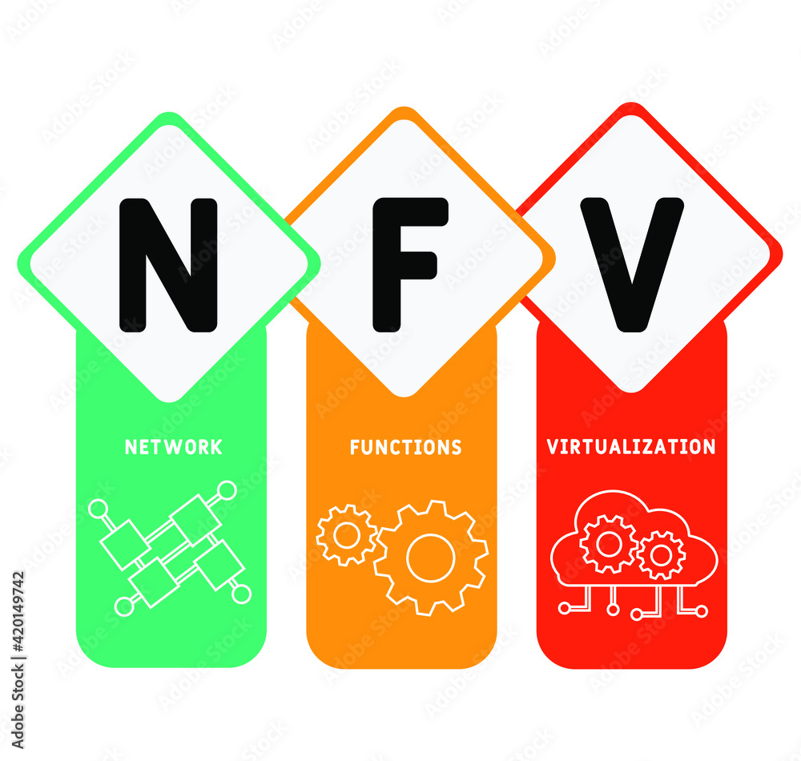

PDS
Computer Vision
Choosing
Cloud providers
https://github.com/siagianp
https://www.youtube.com/@AmelOline/videos
https://github.com/amelcharolinesgn2/IoT_simulator-mqtt-NodeRed
https://github.com/amelcharolinesgn2/Cloud-Infrastructures
https://github.com/amelcharolinesgn2/ClouD-Infrastructure-SISKA-2025
Notes:
https://docs.openstack.org/liberty/install-guide-rdo/overview.html

Slide 2
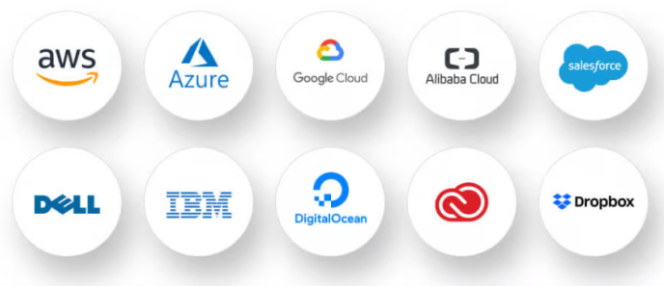
Cloud Providers

Slide 3
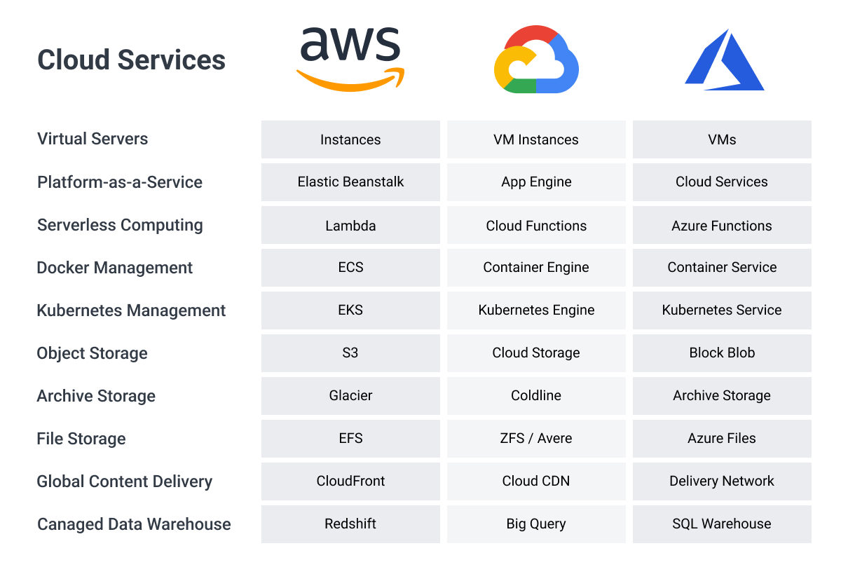
Cloud Service

Slide 4
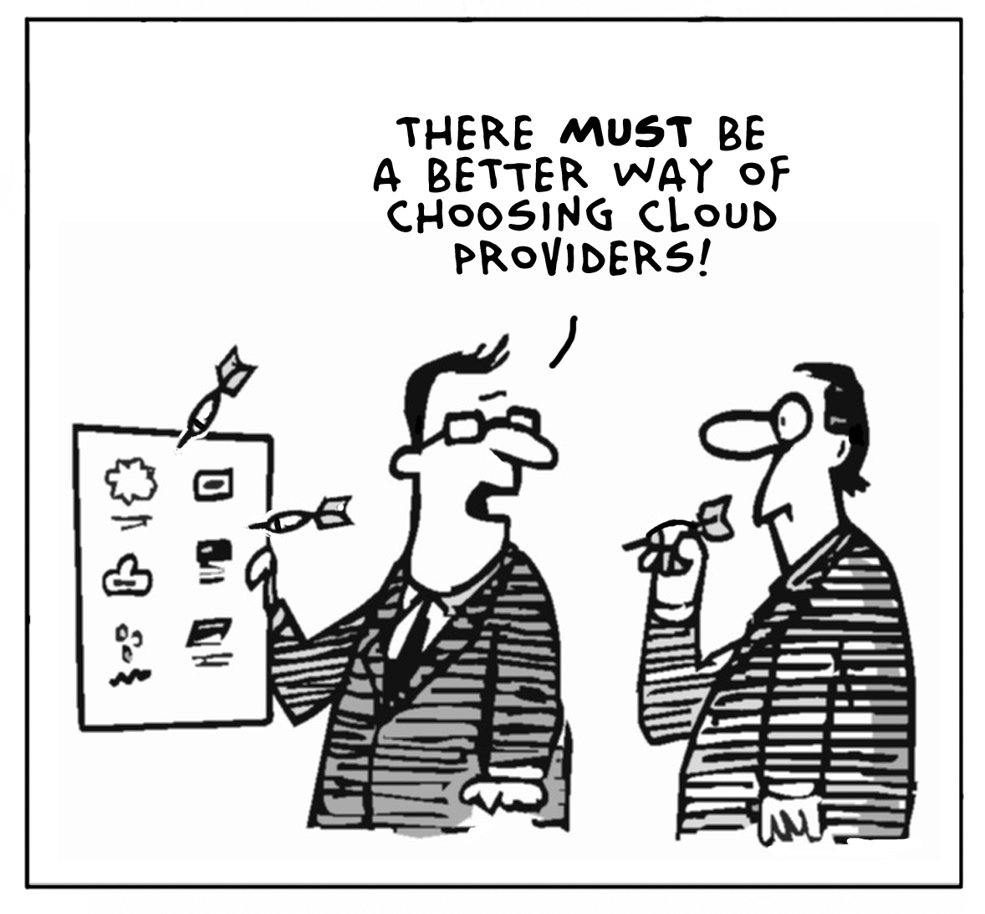
There must a Better Way …

Slide 5
Summary of Previous Lectures
We have developed an understanding of the security issues and countermeasures for cloud computing
current cloud service and delivery models
major outstanding concerns
various aspects of securing the cloud
architecture, data security, and best practices
We identified specific criteria to consider when building a private cloud
We now build on that information to detail security criteria for selecting a public cloud service provider
The consumer does not need to be operationally concerned with the details of the underlying cloud infrastructure
However, there are several open questions for customers that have to do with security and governance of the cloud service

Slide 6
Selecting a CSP: Overview of Assurance

Slide 7
Vendor Claims & Independent Verification
When organizations adopt public clouds, they do not always evaluate the security of their vendors carefully
On the other side, CSPs have not been keen on repeatedly incurring the cost of answering customer’s detailed security questions
Too often, a vendor may state that they are SAS70 or ISO 27002 compliant
Simply stating that a CSP is compliant only amounts to self-certification
The increase in third party audits by some CSPs is a positive trend
But, these audits are not always performed against common test sets
Being able to specify the controls and control objectives that will be verified is not sufficiently meaningful when performing CSP comparisons
What we want to know is
Does a given CSP meet our requirements for security?
How do they stack up against other CSPs?

Slide 8
A Role for Government
The U.S. federal government has been adopting public cloud computing to process non-classified data instead of building new systems
NIST, the General Services Administration (GSA), the Federal CIO Council and other entities have addressed the problem of cloud security assurance from multiple directions
These groups have developed guidelines including the Federal CIO Council’s
Proposed Security Assessment and Authorization for U.S. Government Cloud Computing
The approach taken by several groups is to either adopt or otherwise leverage NIST 800-53 (Recommended Security Controls for Federal Information Systems and Organizations) or similar controls
The goal is to define a security baseline or benchmarks for assessing the security of a cloud implementation or service

Slide 9
Information Security Management Systems (1/3)
Information Security Management Systems (ISMS) are organizational programs whose scope covers every aspect of policy through specific security controls and procedures
The adoption of ISMS has been furthered by ISO/IEC 27002
ISO 27002 outlines control objectives and controls that should be implemented to address requirements identified by a risk assessment
ISO 27001 identifies several categories of security control objectives
Security Policy
The policy should be consistent with business objectives and meet business requirements, and it should comply with laws and regulations
Organization of Information Security
A management framework to implement security, assign security roles, and coordinate implementations across the organization

Slide 10
Information Security Management Systems (2/3)
Asset Management
Establishes responsibility for and protect an organization’s assets
Human Resources
This includes all aspects of personnel, including contractors and third party users, as well as all phases of employment
Physical and Environmental Security
This involves every aspect of ensuring a controlled and protected environment for information facilities and equipment
Communications and Operations Management
Defines responsibilities for information processing facilities and establishes procedures for their operation and control
Access Control
Controls access to information and ensures that controls meet organizational requirements

Slide 11
Information Security Management Systems (3/3)
Systems Development and Maintenance
Identifies security requirements before starting the development process or any other aspect of implementation or acquisition
Verifies that applications and controls operate correctly and are appropriate
Information Security Incident Management
Reports security events, incidents, and weaknesses
Establishes formal processes and procedures for managing incidents
Business Continuity Management
Establishes and use a business continuity management process to counteract interruptions and protect critical processes
Compliance
Ensures compliance with legal and regulatory requirements
The ISO 27000 series recognizes that people, processes, and technology are equally important aspects of effective security

Slide 12
Independent Verification (1/3)
Obtaining accreditation is both time consuming and expensive
Doing this is becoming a cost of a CSP doing business
Without third party accreditation of vendor security claims, cloud consumers can only trust that CSPs security claims are accurate
Public cloud users do not have the ability to review details of the security implementation, processes, and procedures of a public cloud
It is not prudent for a CSP to expose technical details of cloud security to potential customers, just to win their business
The best method of addressing this issue is to place value in trusted third party accreditations

Slide 13
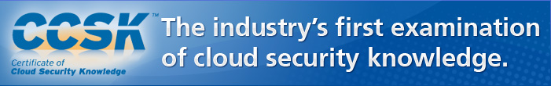
Independent Verification (2/3)
SAS70 (Statement on Auditing Standards No. 70), Type II
This certification focuses on a CSPs infrastructure, policies, and procedures to assure that it follows best practices in minimizing the risk of service disruption and to ensure security of data
ISO 27001/2
More comprehensive than SAS70
Cloud Security Alliance (CSA)
In 2010, CSA revealed an initial program for accreditation / certification oriented toward certifying competency in cloud security practices

Slide 14
Independent Verification (3/3)
PCI DSS
A standard developed by the Payment Card Industry
FISMA, FedRAMP, and NIST 800-53
U.S. federal government programs to measure security for federal IT systems
Industry organizations that set standards and provide certifications
Uptime Institute
“Provides education, publications, consulting, certifications, conferences and seminars, independent research, and thought leadership for the enterprise data center industry and for data center professionals”

Slide 15
Vendor Transparency (1/3)
Customers of a public cloud service have expectations that the CSP will offer the appropriate level of security and governance to protect their data
Unfortunately, vendor claims about security are often made without sufficient justification or they may be very vague and generic
CSPs may also transfer liability to customers
Customers seek a degree of understanding of what the provider actually does and would do under various circumstances
The term transparency is used to describe the degree of visibility into security policy and operations that a CSP offers to its customers
Although customers should not expect a CSP to detail how security is implemented, they expect a CSP to be open and accountable about security practices

Slide 16
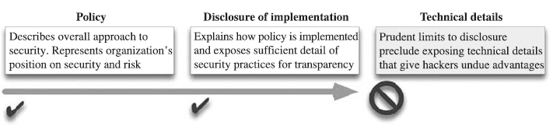
Vendor Transparency (2/3)
Revealing extensive information about security is often prohibited by the organizational security policy
What should be kept secret includes specific implementation details that could be exploited by a hacker
CSPs should disclose enough information to
empower customers/users to make informed decisions about choosing a CSP or implementing additional security procedures or measures

Slide 17
Vendor Transparency (3/3)
CSPs Security Policies and Standards
Sufficient details to allow customers to be informed in their security expectations
Security Implementation and Procedures
Enough details to allow customers to decide if the CSP should be entrusted with customer data
Liability and Risk
No information that would result in liability for the CSP or risk to customer data
Service Issues
Specific information about security incidents, including their scope and how the CSP is rectifying the situation
Regulatory and Legal
Any information that laws and regulations mandate to be disclosed
Division of Responsibilities
Areas for which CSPs are and are not responsible

Slide 18
Selecting a CSP: Overview of Risks

Slide 19
Risk Will Vary by Customer and by CSP
We introduced the concepts of risk and risk management
Risk can be expressed as a relationship between threats, vulnerabilities, countermeasures, and asset value
We looked at various perceived cloud computing risks, and how one can assess and mitigate risk
We looked at risk from the standpoint of data in motion and data at rest for public SaaS, PaaS, and laaS
With that background on cloud computing risks, one should then consider the requirements of individual organizations
Likelihood of an incident versus its expected business impact
some incidents are highly unlikely yet they may have a very high impact
other incidents are highly likely, but have a very low impact

Slide 20
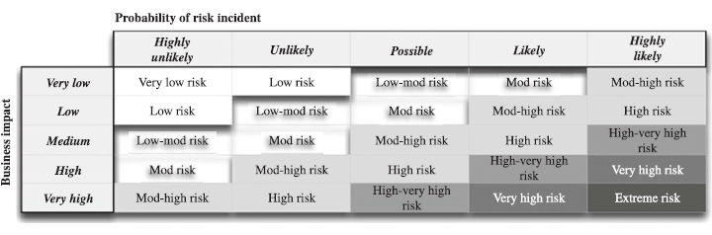
Probability of Incident Versus Business Impact

Slide 21
Assessing Risk Factors
Selecting a public CSP should entail an assessment of the risk that customers or data are subject to
The nature and level of risk will vary according to many factors, including cloud architecture and security measures
Overall, risk can be broadly classified into three categories
Technical Risks: isolation failure, data interception, data leakage, and malicious probes
Policy and Legal Risks: loss of governance, compliance failures, jurisdictional issues, subpoenas, and licensing issues
Operational Risks: malicious insiders, errors and misconfigurations, bandwidth problems, social engineering, loss of backup data, physical security compromise, loss of encryption keys

Slide 22
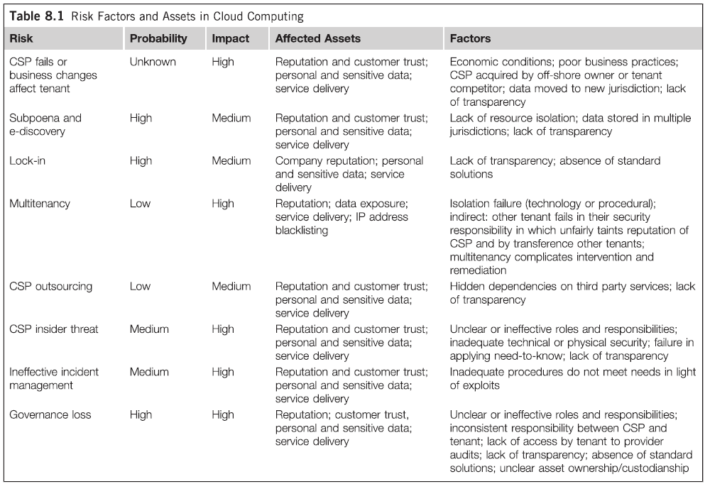
Risk Factors and Assets in Cloud Computing

Slide 23
A Deeper Look at CSP Business Viability
A CSP may fail or be subject to adverse circumstances
This a risk for a customer who comes to rely on a cloud service
The viability of the CSP is an important factor when choosing a public cloud
The ability of a CSP to provide adequate security can be undermined if the CSP can no longer appropriately fund security relevant aspects of cloud operations
Various scenarios are possible, including
Staff Reductions: can leave remaining staff to assume the duties of departed staff or duties they are not trained for
Security Infrastructure Relevancy: if a CSP can’t keep their security technology relevant, its security will become ineffective
Business Model: CSPs might initially advertise that their service maintains privacy, but if the business model evolves that agreement may be void

Slide 24
A Deeper Look at CSP Business Continuity
In the event of disasters that would impact the cloud, the provider should have a formal disaster recovery plan
The plan should be kept relevant and periodically tested
It is especially important to understand the procedures and design the cloud provider has in place to ensure its viability
Disaster recovery not only includes natural events like earthquakes, fires, or tornadoes
It also includes how you recover from disasters caused by human error
If the CSP has a disaster recovery plan in place, does the plan itself compromise the security of the cloud?

Slide 25
Selecting a CSP: Overview of Criteria

Slide 26
Security Criteria (1/2)
Many aspects of a CSP should be examined and “quantified”
Security Policies
The quality of a CSP’s security policy is indicative of how seriously they take their responsibility for security
Security Staff Independence
Security operations staff should cooperate with the operations staff, but maintaining independence
Change Management
The authority to make changes must be clearly defined
Upgrades and Patch Management
Upgrades and patches should be applied in a timely and safe manner to limit exposure
Scans
The CSP must perform regular vulnerability assessments
Any issues must be evaluated and promptly rectified

Slide 27
Security Criteria (2/2)
Forensics
Security relevant logs must be retained long enough to assure their availability to meet forensic and legal requirements
Logs contribute to understand how an incident occurred and its impact
Incident Management
Not only is a customer interested in the response time frame (detection, incident disclosure, remediation, review, and public disclosure)
Customers may also require responsive cooperation from a CSP to support resolution of customer identified incidents
Business Continuity
Recovery Point Objective (RPO) is the maximum amount of data loss that is acceptable after a data loss incident
Recovery Time Objective (RTO) is the maximum amount of time that is acceptable for restoring and regaining access to data after a disruption

Slide 28
Revisiting Defense-in-depth
Layers of a defense-in-depth model for a public cloud
Hardened Routers
Routers are usually the first point of entry to the network
They should be hardened to prevent common threats like spoofing
Firewalls
Firewalls should be installed at the edge of the network as well between critical security zones within the infrastructure
Application-level Proxy or Firewall
A proxy applies the same principles of a firewall at the application layer
Security Event Management (SEM)
Security event generation, collection, analysis, and alerting process
Host and Network Intrusion Detection/Prevention
Detecting potential intrusions, misuse, or insider threats

Slide 29
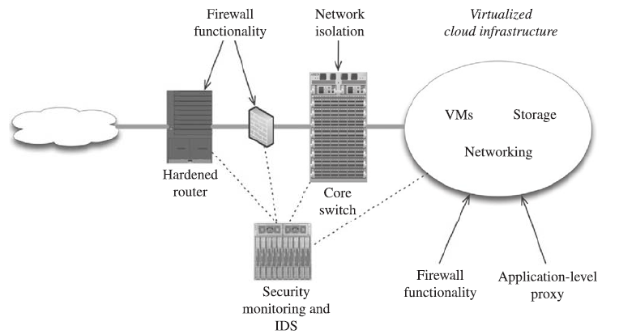
Defense-in-depth Example

Slide 30
Security Criteria: Other Considerations
Patch Management
Security Operations Center
Infrastructure
Platforms
Data Backups
Security Practice
Service Level Agreements
Elasticity
Data Center Location
Staff

Slide 31
Patch Management
A formal patch management process is a key to ongoing security
With a public cloud you are relying on the cloud provider to patch their systems
This is of paramount importance when you are talking about patching the foundation, such as virtualization-level vulnerabilities
Operational VMs may also require patching
The sheer number of VMs in a virtualized cloud makes patching all VMs unrealistic
Virtualization brings new opportunity to the traditional patch process
It is easier to patch a golden image and then copy customer components to a copy of that image

Slide 32
Security Operations Center
The equipment protecting an infrastructure often is only as good as the engineers managing it
In the event of a critical security issue, there needs to be a team of qualified engineers in place to
assess the threat, diagnose its impact, and react accordingly
These engineers need to have a primary responsibility of security, but not of operations, as the two roles can conflict
This team is often called a Security Operations Center (SOC) in contrast to the Network Operations Center (NOC)
The CSP should also be responsive to requests that you submit
This will have an impact on your ability to secure your use of the cloud

Slide 33
Infrastructure
Although a customer purchases a service that is abstracted away from underlying infrastructure, the CSPs infrastructure is of great importance when considering security
Ultimately, your data is only as secure as the infrastructure and physical locations are
A CSP is unlikely to provide details such as exact specifications of the servers or their patch levels
However an organization adopting that cloud should have more than just an understanding of the policies that are in place to address these concerns
They should also have a sufficient understanding of the environment in which their business will operate from

Slide 34
Platforms
The kind of servers that are deployed along with the foundational software that comprises the cloud can be valuable information for customers
If a cloud is built on virtualization, an understanding of how virtualization is accomplished is important
There are several virtualization products available that form clouds, including VMWare, Xen, and Microsoft’s Hyper-V
Virtualization security is still an evolving science
There is currently a tremendous amount of research and development
An understanding of what kind of platform is used allows the subscribing organization to know what threats might exist as new vulnerabilities are discovered

Slide 35
Data Backups
A basic element of any disaster recovery plan is data backups and moving those backups off-site
This can take the form of backing data up to high capacity storage tapes and moving those tapes off-site
The same can be done with disk-based storage or remote network-based backups
The act of backing up the cloud might compromise security
Is encryption used as backups are created?
When the backups are physically being moved to another location is there a chain of custody?
Are there any measures in place to insure that the data has not been tampered with during the move?

Slide 36
Security Practice – Multi-Tenancy
One of the most important aspects of a CSPs security policy is to understand how one subscriber’s data is kept separate from another user’s data
An MIT paper described how security researchers found a way to breach the segmentation that Amazon had in place in their Elastic Compute Cloud (EC2)
They proved that exploitation was possible from within one virtual machine to another virtual machine simply by existing on the same host within the cloud (co-residence)
They were able to successfully exploit how Amazon attempts to randomize the hosts selected to house VMs
Amazon very quickly reacted to the vulnerability and further randomized their host selection process, along with other changes

Slide 37
Service Level Agreements
Service Level Agreements (SLA) are a critical component of a public cloud’s availability guarantees
A cloud must be available and network reachable to provide any value to its tenants or customers
An SLA is the primary means a customer has of assurance that availability will be maintained or the CSP will incur penalties
As an alternative to third party certification, similar SLAs can apply to security
How good is the cloud if it is available but insecure?
Although a security SLA will not guarantee security, it does provide assurances that appropriate policies and procedures are in place
If they are not met then there is a penalty for the CSP

Slide 38
Elasticity
The on-demand ability for a cloud to increase capacity dynamically and “without limits” affects the availability of the cloud
Availability is a core security property, and availability is subject to DDoS and numerous factors including misbehaving processes that attempt to consume all available resources
Make sure you understand how the cloud provider scales their cloud and balances load
How do they accommodate customer growth?
How load is shared among nodes, and how does that affect your adoption of the cloud with your particular application?
Usually this can be quantitatively tracked in the form of a SLA with availability metrics

Slide 39
Data Center Location
The location of the data center(s) implementing the service has many implications
A prospective customer should ask many questions about this
Is the cloud made up of multiple data centers, perhaps in multiple countries?
Where will data be stored?
Would the CSP store sensitive information that are not allowed to be stored outside certain borders?
How stable is the country or region in which the data center operates?
Is it at risk to law enforcement without due process?
Does the stored information require or use encryption?
At the very least, a customer should know in which jurisdictions the nodes that form the cloud are located

Slide 40
Staff
A cloud customer will have very little (if any) direct exposure to the personnel managing that cloud
This is certainly true for most SaaS and it is largely true for PaaS and IaaS
In terms of security, it is important to understand the hiring policies and procedures of the public cloud provider for key personnel involved in the development and management of the cloud
Are background checks performed on CSP personnel?
What are their minimum required credentials to be considered?
What system of checks and balances is in place to prevent malicious employees from compromising the integrity of the cloud?

Slide 41
Summary
Security Criteria: Selecting an External Cloud Provider
Overview of Assurance
Vendor Claims & Independent Verification
Vendor Transparency
Overview of Risks
Assessing Risk Factors
CSP Business Viability
CSP Business Continuity
Security Criteria
Defense-in-depth
Other criteria
Patch Management, SOC, Infrastructure and Platforms, Data Backups, Security Practice, SLAs, Elasticity, Data Center Location, Staff

Slide 43
Thx

